Slide 1

GUDLAVALLERU ENGINEERING COLLEGE
(An Autonomous Institute with permanent Affiliation to JNTUK , Kakinada) SHESHADRI RAO KNOWLEDGE VILLAGE
Gudlavalleru – 521356
Andhra Pradesh
2021
SMART SECURITY AND SAFTEY SOLUTIONS BASED ON IOT FOR LARGE INDUSTRIAL PLANTS
TEAM NAME: ECE_B02
G. Ram Mohan Reddy
G. Siva Krishna Kumar
G. Chaitanya Reddy
G. Seetharam
G. Prathibha
Mentor : N. Divya

Slide 2
Content
Objective
Introduction
Requirements
Inputs and Output
Advantages and Disadvantages
Code
Result
Conclusion

Slide 3
Objective:
There is a sudden exponential use of security systems in our day-to-day life. For example, security in a business space, organization, or bank locker is important to every individual now. The main aim of this paper is to enhance the traditional security system. The security system based on the IoT platform has the potential of interacting real-time with the device. This entire economic system using IoT in real-time will allow mobile devices and computers to remotely track the activities occurring at the location where the IoT device is placed and records all the activities, which will be saved on one's cloud storage account

Slide 4
Introduction
Now a days Internet of Things (IoT) is basically a fast-growing technology. IoT is basically the combination of physical device, software, sensors, network, wired or unwired technology etc... which is basically used to make an ecosystem of computing like collect and exchange data. In the Internet of Things applications, physical sensors collect different types of data from the field and transfer those data to the Internet the requirement for security makes many of us seek for alternative ways so as to safeguard their property. We are developing a system which is an integration of several mini system. This system generates Alerts/Alarms or take intelligent decisions using concept of IoT.

Slide 5
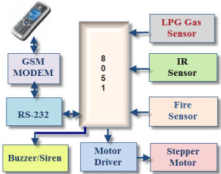
Block Diagram

Slide 6
Explanation
The above Block diagram shows the creating the alert by sending message to the mobile phone using the GSM Module. There are high number of large industrial plants are there in the World. When there was any fire accident or any person missing in the factory, we provide some sensors to detect the fire and we uses the camera to detect the persons who are entering and leaving the industry. Thus, when an accident happens the platform, we developed send signal to buzzer and it will sound and using the GSM module it sends message to the mobile phone which is connected to it and also nearby fire station.

Slide 7
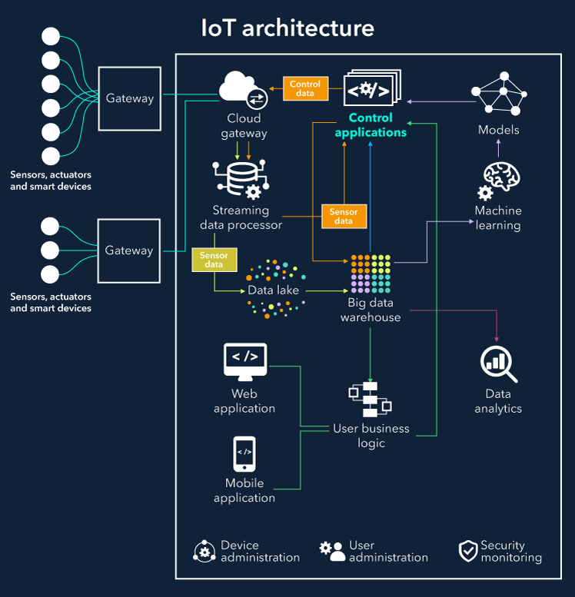
Architecture

Slide 8
Explanation
To demonstrate the feasibility and effectiveness of this system, devices such as GSM, Bluetooth module, PIR motion reed sensor, gas sensor and laser sensors have been integrated with the proposed Security system for an organization. This integration is basically done for the purpose of higher security to maintain an organization in a proper and secure way. This system has two main modules: the hardware interface module (Arduino, GSM, Bluetooth and Sensors) and also the software communication module (Web application & Android application). The core component of the system is Arduino Mega 2560 microcontroller that is additionally capable of functioning as a micro web server and also the interface for all the hardware modules. The first one is controlling the appliances of the organization and second is controlling the security of the organization.

Slide 9
Requirements
Hardware Requirements:
8051 Microcontroller
Fire sensor
Buzzer
IR sensor
LCD display
LPG Gas sensor
GSM module
Wi-Fi dongle
Software Requirements:
Python Idle
Server
Watson Studio

Slide 10
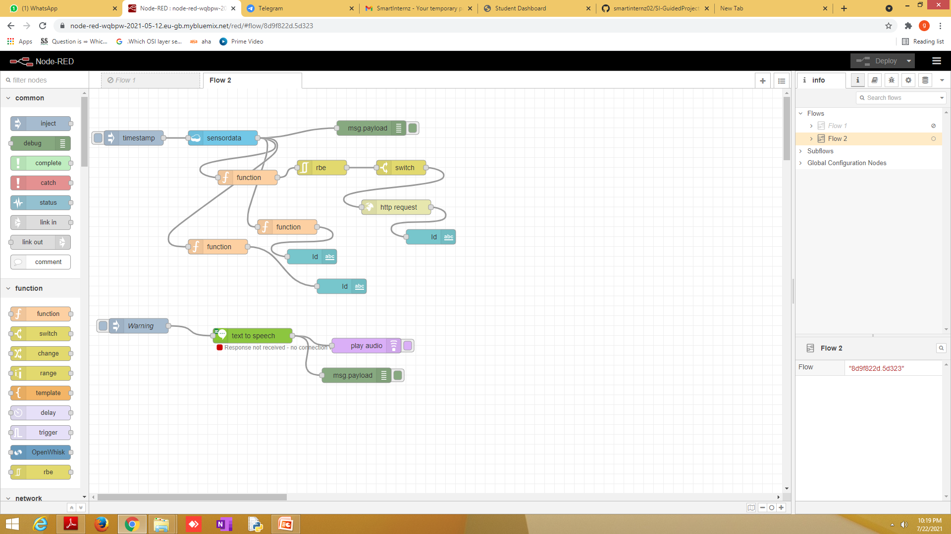
Input

Slide 11
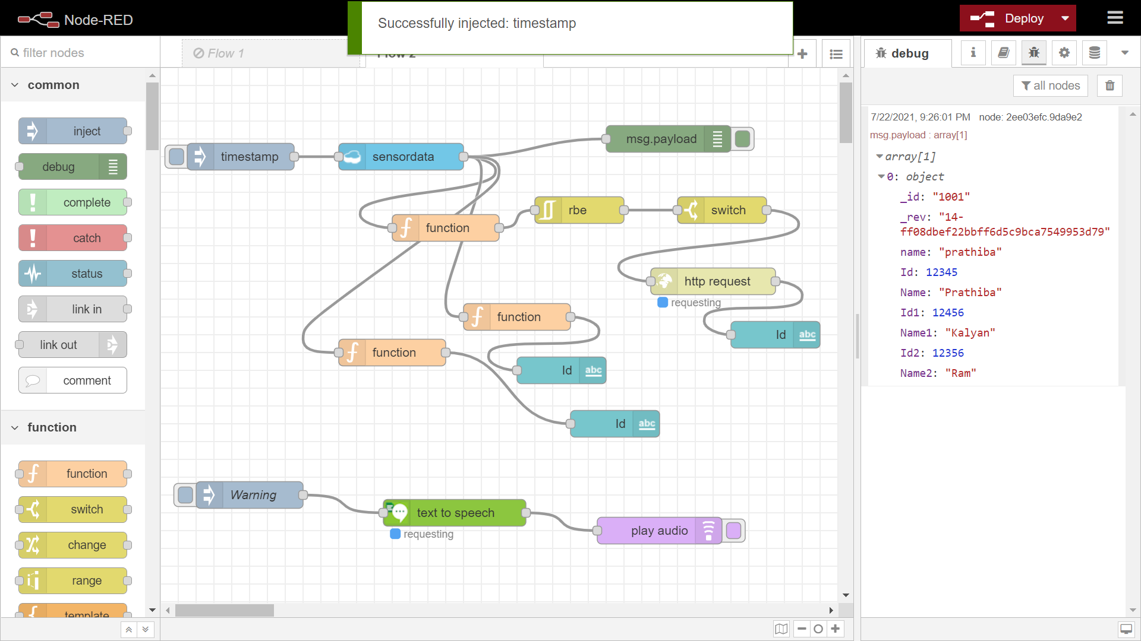
Output

Slide 12
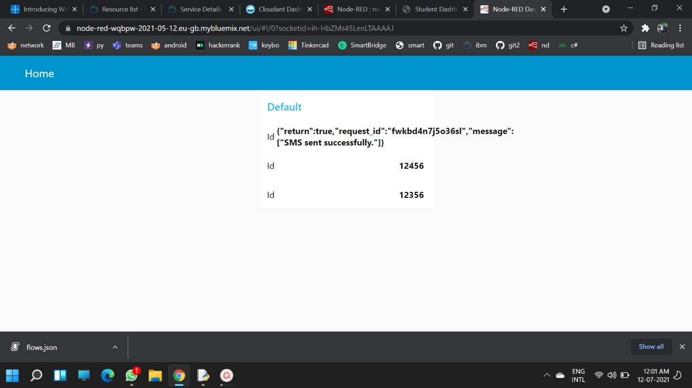
Result

Slide 13
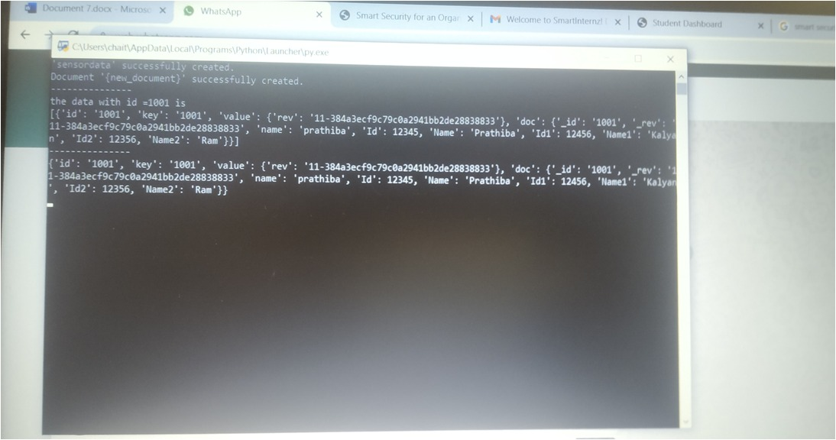
Code :-

Slide 14
Advantages
A fleet of IoT devices can help businesses optimize their workflows and lower operating costs because they provide real-time information.
IoT devices can manage, monitor and alert staff of changes in processes or productivity, helping them make smarter decisions about work.
IoT devices can help businesses gather, transmit and analyze the data they have on customers, helping create a superior customer experience that engages them at a deeper level and increases customer loyalty.
IoT devices help organizations gather data to identify insights about their business, both internally and externally.

Slide 15
Disadvantages
The biggest problems, con or disadvantage of a smart home system is the cost. There are quite a number of companies that provide the smart home system, but all of them are quite expensive.
The basic requirement for the smart home system is the internet. Without a good and strong internet connection, you will not be able to take control of this.

Slide 16
Applications
Automated and remote equipment management and monitoring.
Reduce the cost of quality management systems.
Improve quality through continuous monitoring.
Robotics maker Fanuc is serious about reducing downtime in industrial facilities.
As the field of agriculture becomes more of a science and less of an art passed down the generational line, with self-driving tractors.

Slide 17
Conclusion
Developing an industrial system using internet of things technology. We are intended to produce an application near future for the observation of industrial appliance. We successfully developed the smart security for large scale industries to avoid the accidents using IBM IoT Watson Platform.

